Slide 1
1 Planed
Planed 1
Have a rough idea of the PE format and the analysis of PE format.
Download PE-bear ,HxD，010Editor and IDA.
Finish learning the part1 overview and part2 DOS Header,DOS Stub and Rich Header.
4

Slide 2
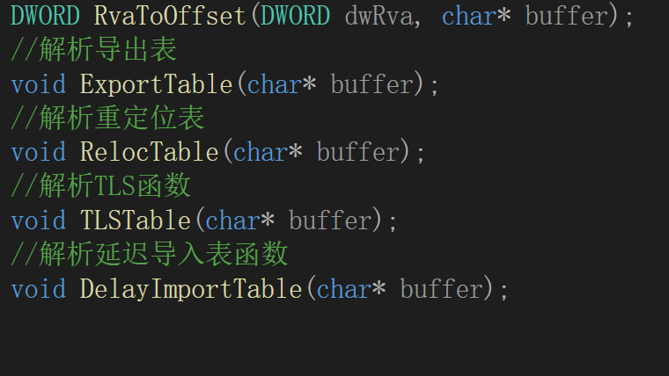
1 Results
Results 1
Finished a part of the online course called “Windows the analysis of PE format” in bilibili.
In imitation of the online course i did some coding of analysing the PE format,the screenshot on the right .The five functions i have realized by coding.By coding the functions i have a general idea about the way to store the exe file in the memory.I know the file is saved in hexadecimal form,when we run the file there will be a virsual memory for the file,so the file will have a virtual address.As a PE file,each substruct has a virtual address,i can define a pointer to get the start virtual address of each part and realize some operations.
4

Slide 3
2 Results
Results 2
Up to now i failed to download the IDA,but it doesn’t matter,i will do that.
I have just studied the part1 and DOS Header,DOS Stub.
These days i read English everyday!!!（感觉看英文都比中文顺眼了）
4

Slide 4
Results1 in Chinese
Results 1
看完了b站上的一个PE文件解析的网课，时间是3h30minutes但是我看了大概七小时
模仿着网课上面的code写了一些函数用于解析PE文件结构第一个是用来计算偏移量的，第一个参数是某个表的虚拟地址，第二个参数是读取的这个exe文件的指针，指向文件头。目前自己的了解就是每个PE文件在运行时会被放到电脑的虚拟内存里面，分配空间和地址。我定义一个指针指向某个表的头部，然后就可以对这个表进行一些操作了。但是这部分的学习是在看那部分blog之前，理解上会有一些不全面甚至错误。
4

Slide 5
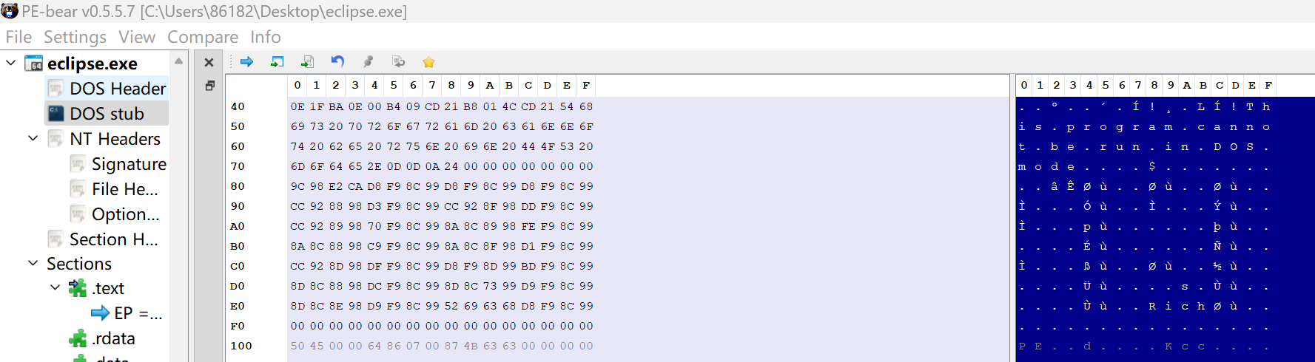
1 Challenges and Solutions
Challenges and solutions 1
I want to get a tool that can analyse a PE file in hex.
I get the file called “PE-bear” in github and open a PE file by it.
4

Slide 6
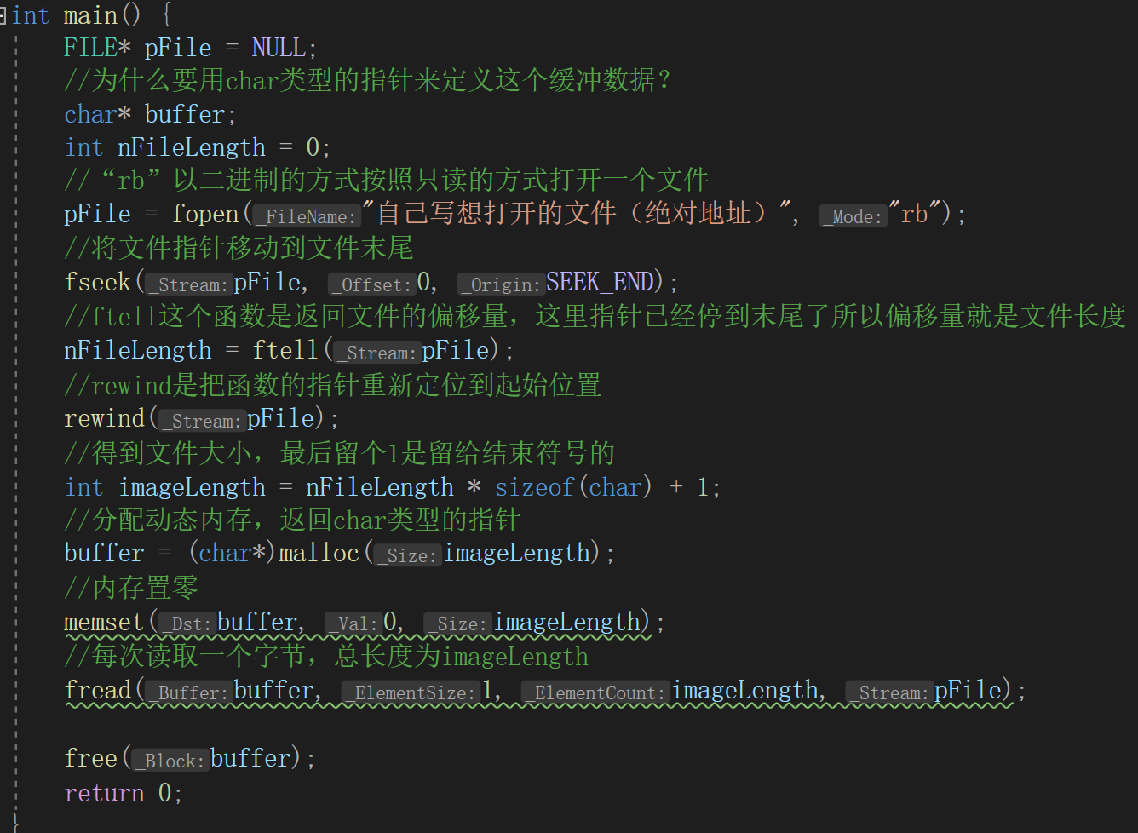
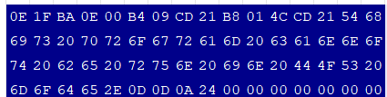
2 Challenges and Solutions
Challenges and solutions 2
Why the data “buffer” is defined as a char pointer.In C language the char is just a byte,two hexadecimal numbers.why read the file by one byte and one byte?
By the PE-bear,look at the figure.The ‘0E’ occupies two hexadecimal numbers,a byte.Maybe it is the reason?
意思就是由PE-bear解析后，发现这个编码方式每一小段都是一个字节，用char类型的指针来读取这个文件正好。
4

Slide 7
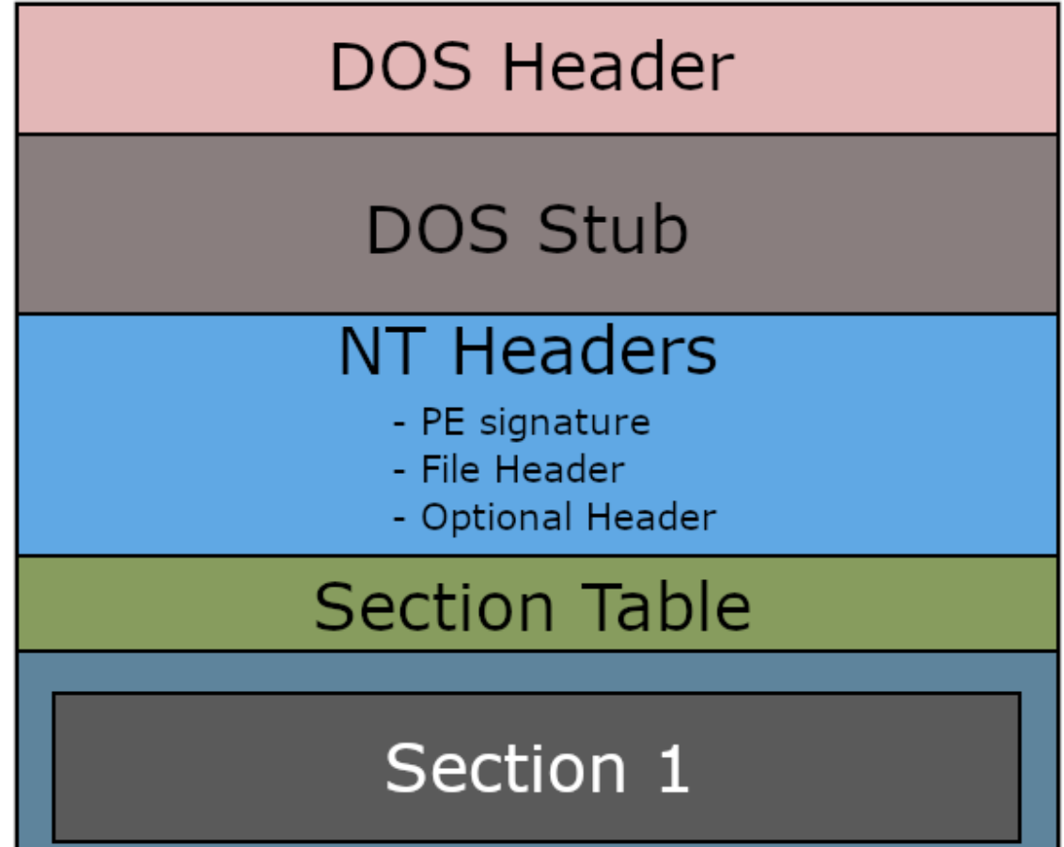
3 Challenges and Solutions
Challenges and solutions 3
Does Windows include the DOS?Does the Windows still use DOS?I think that the DOS is still used to operate the disk,right?Otherwise how does the OS loader identify the DOS Header.The DOS Header is like a sign to tell the OS loader that the file is a PE file that is executable in MS-DOS,right?
The DOS Header and DOS Stub is just a program used to stop the file running when the PE file is run in the MS-DOS ?
I know it from the last figure!!If the PE file is running in MS-DOS the loader will run the program that print “......”,else the loader parse the PE Header.
4

Slide 8
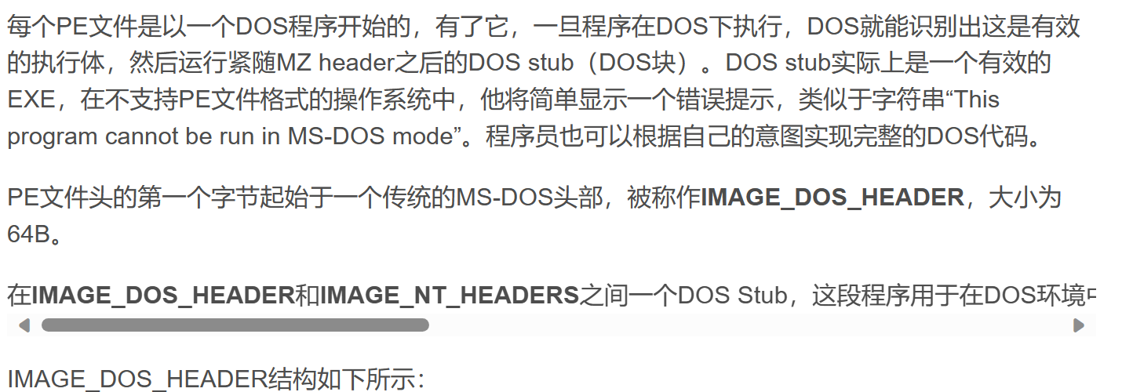
4 Challenges and Solutions
Challenges and solutions 4
I try to know what is DOS stub?It says the DOS stub is a DOS section and a EXE ?I wonder that a exe includes the whole PE structure,right?I means a EXE includes the DOS Header,DOS Stub,NT Headers,Section Table.But it says the DOS Stub is a EXE,why?
I have some problem reading the assemble language writen in your blog.
4

Slide 9
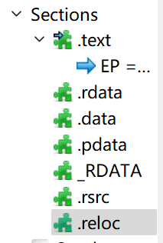

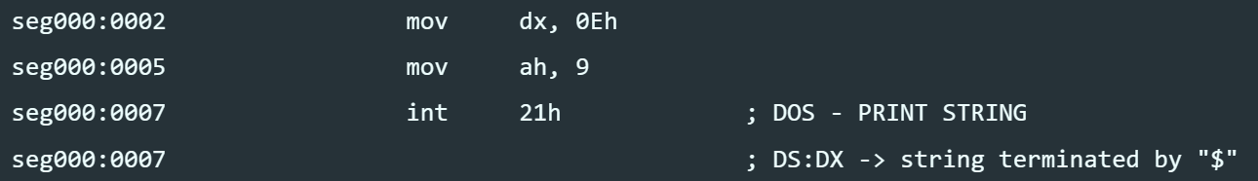
Questions
Questions
I know that the .text,.rdata......is the image section header but i have a silly question why they are called image section header,and if i can called them section header?The ‘image’ means what?
Why the value is ‘5A4D’ not ‘4D5A’?
You disassemble the DOS Stub and analyse it but i don’t understand these three lines.Expecially the last two line,you wirite ‘invokes interrupt 21h’,but i know little about how to invoke interrupt by just a line of code.
（大致意思：如何调用的这个接口，为什么调用后就能打印出一个string）
4

Slide 10
Questions
Questions
Why the PE format is used widely?Does it have some special features?Such as it is more efficient?
4

Slide 11
1 Plan
plan 1
write a blog about learning PE in csdn.
Successfully download the IDA and know how to use it.
Finish the study of the PE format next week.
4

